Slide 1
Noise2Void(N2V)
Honghong Fang
Supervisor: Dr. Mykhailo Vladymyrov
Master thesis progress report
Notes:
Today, I would like to present my progress report, focusing on Noise2Void (N2V). N2V is a powerful deep learning technique that has recently gained a lot of attention in the field of image processing. It is particularly useful for denoising images. In my presentation, I will provide an overview of N2V. I will also share the results of my experiments and demonstrate how N2V can be used to enhance image quality.

Slide 2
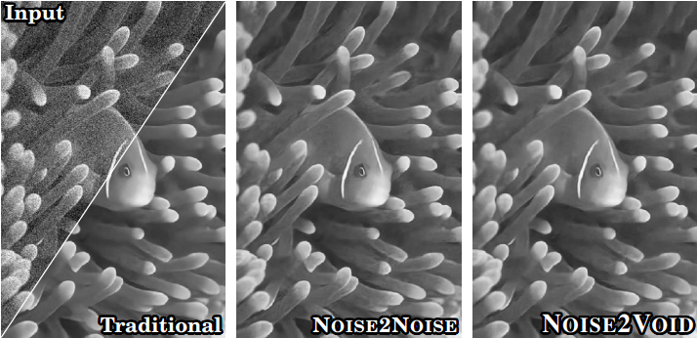
Noise2Void(N2V)-denoising
Traditional deep learning methods
(CARE) about image denoising is that
training pairs of noisy input and clean
target images.
Noise2Noise (N2N) can also be trained
without clean targets but independent
pairs of noisy images.
Noise2Void(N2V) does not require
noisy image pairs, nor clean target images.
N2V is particularly well-suited for
denoising microscopy images, containing
complex structures, with high level of
noise.
https://openaccess.thecvf.com/content_CVPR_2019/papers/Krull_Noise2Void__Learning_Denoising_From_Single_Noisy_Images_CVPR_2019_paper.pdf
Notes:
Here is a brief introduction to the development of image noise reduction, which has gone through three stages.
In reality, clean target images and images with regular noise distribution are difficult to obtain.
These three images compare the output images after the three denoising methods, and the visual denoising effects are basically the same, so even though there is no clean target image, N2V also has a good denoising effect.

Slide 3
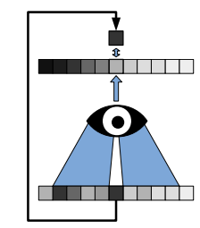
Blind-Spot Network
The basic idea behind N2V is that the central pixel value of a noisy image can be estimated by training a neural network to predict the missing central pixel value from its surrounding pixel values.
Target
Prediction
Input
https://openaccess.thecvf.com/content_CVPR_2019/papers/Krull_Noise2Void__Learning_Denoising_From_Single_Noisy_Images_CVPR_2019_paper.pdf
Notes:
So what's the basic idea for N2V

Slide 4
T cell trafficking dataset
Dataset from Dr. J. Mapunda of Spinal cord window in VE-Cad GFP x AQP4-mRuby 3 mouse model
Training data 3 timeframes
4 channels (Blue, Green, Red, FarRed)
Model training and inference performed on the GPU nodes on the Ubelix cluster
Notes:
Next I will show different datasets, let us observe the results of different datasets after N2V training and prediction

Slide 5
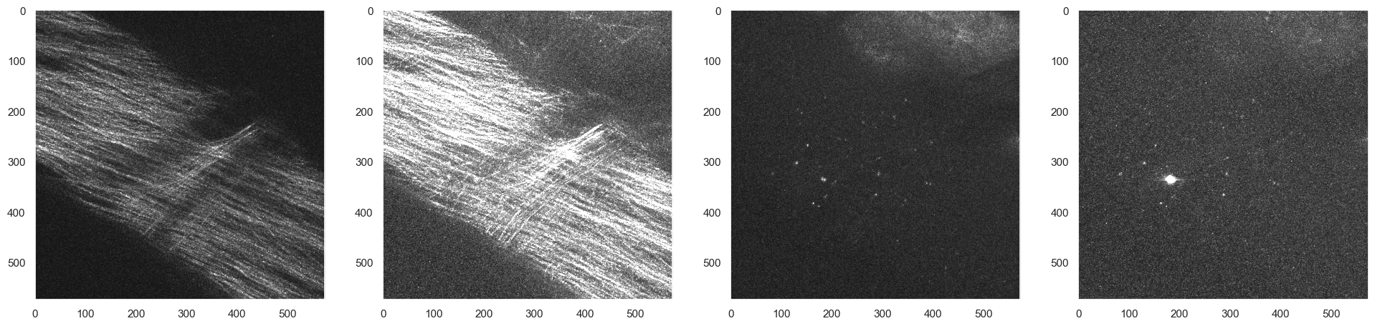
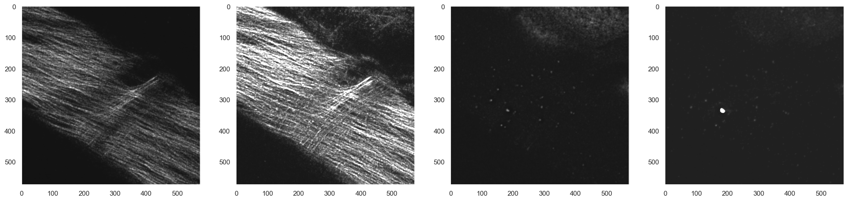
Time 0020, before training
Time 0020, after training
Notes:
In the absence of ground truth data, we can only judge the results visually. In the red channel, SHG is observed here. We can see that after N2V processing, the structure of the fiber is more clear. In the farred channel, the target of observation is CD4 T cell. After N2V, other non-CD4 T cell noise becomes blurred. even disappear

Slide 6
Microphages, Microglia and PECAM-labeled cells dataset
Dataset from Dr. M. Vladymyrov of Spinal cord window in CX3CR1 GFP x CCR2 RFP mouse model with systemically injected aPECAM-1 labeled antibody.
Training data 3 timeframes
2 channels (Blue, Red,)
Model training and inference performed on the GPU nodes on the Ubelix cluster

Slide 7
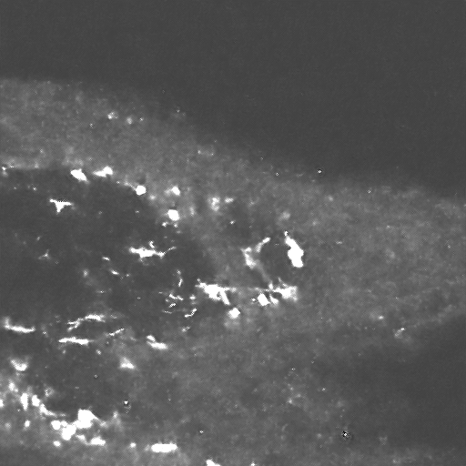
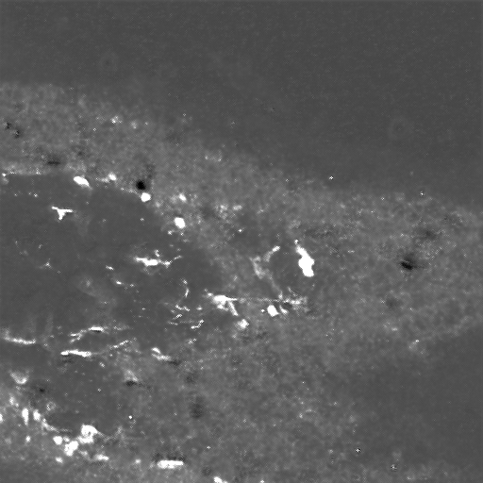
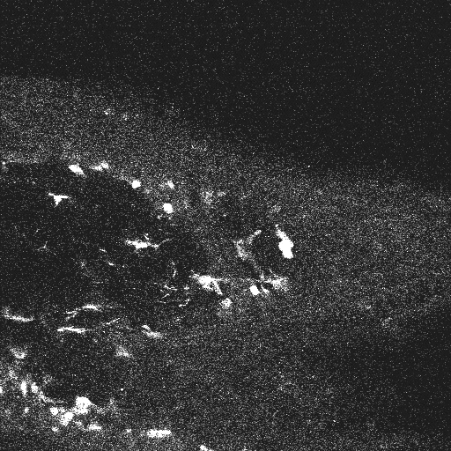
Comparison of 2D vs 3D model
Red, 2D
Red, 3D
Red, Raw
Notes:
Since the image produced by the 2-photon microscope is a multi-frame and multi-channel image, we consider it to be a three-dimensional image, and a single-frame single-channel image is also considered to be a two-dimensional image. Here we compare the different results of applying N2V to process two-dimensional and three-dimensional images. At the same time, the original image is compared
Through visual observation, the 2D image structure is closer to the composition structure of the original image than the 3D structure. Due to the effect of blind spots, 3D uses the pixel information of adjacent frames when denoising, resulting in wrong structural reconstruction. Therefore, we believe that using a single frame image for 2D image training is better.

Slide 8
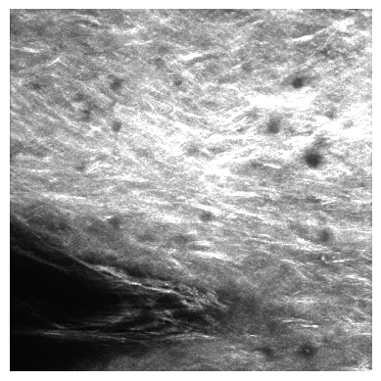
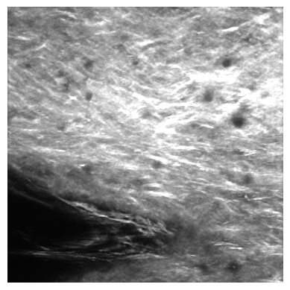
Comparison of before and after training
Blue, Time 0001, raw
Blue, Time 0001, denoised
Notes:
This is the comparison between the result image after two-dimensional training and the original image. We can clearly observe that the structure in the middle part is smoother and clearer.

Slide 9
Choroid Plexus dataset
Dataset from Amandine Brenna of cell trafficking in the Cannula implanted Fox-J1 Cre x Ai14 x CLDN-5 GFP mouse model with systemically injected T cells
1 channel (Red)
Model training and inference performed on the GPU nodes on the Ubelix cluster

Slide 10
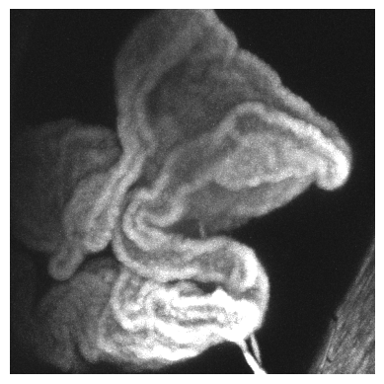
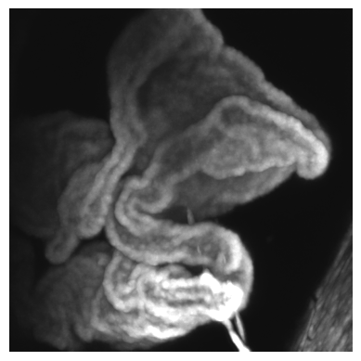
Comparison of before and after training
Time 0008 , raw
Time 0008 , denoised
Notes:
We also apply 2D N2V denoising on recent datasets. The second image is after denoising, and the cells can be seen here, which is clearer than the original image

Slide 11

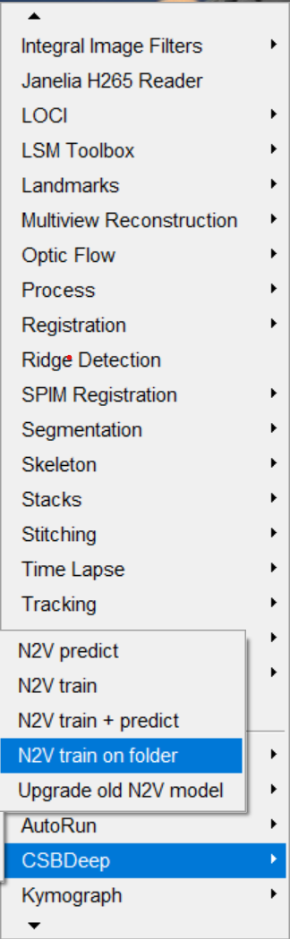
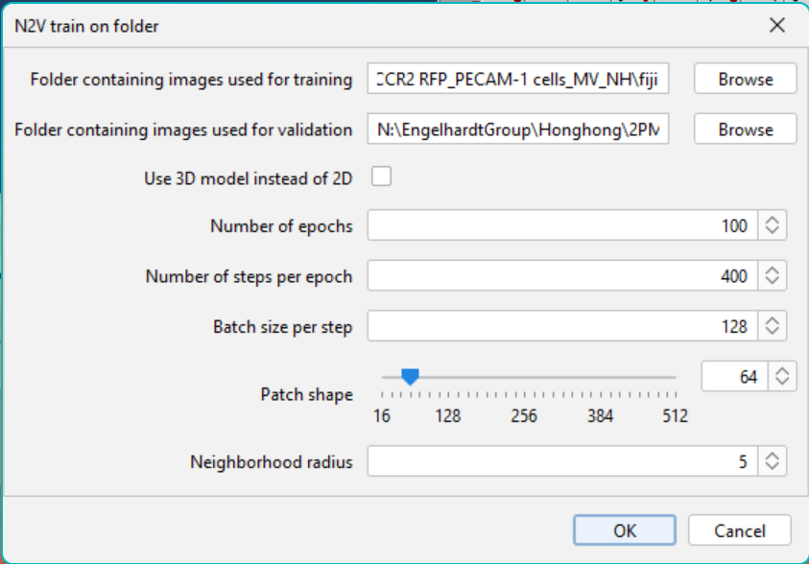
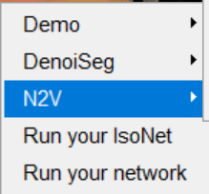
How to work in Fiji
With the GPU installed on the Processing PC at the 2-photon microscope, the training speed is significantly increased
https://imagej.net/plugins/n2v
Notes:
The good news is that we can deploy and apply N2V to image denoising in FIJI. There are related documents on the Internet to guide us to upgrade and install the corresponding N2V and GPU. The screenshot here is the fiji after I installed N2V, which can be found in the plugins menu
What I want to emphasize here is

Slide 12
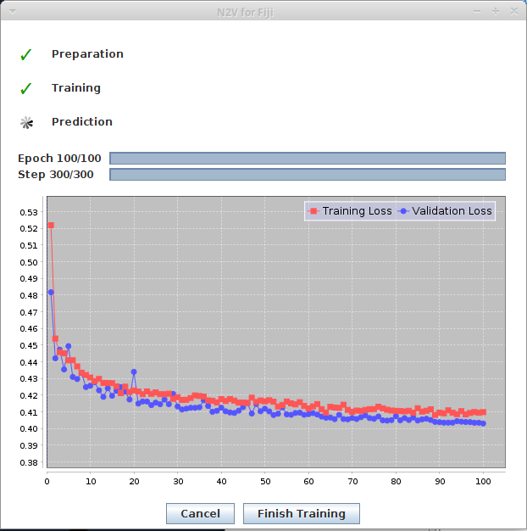
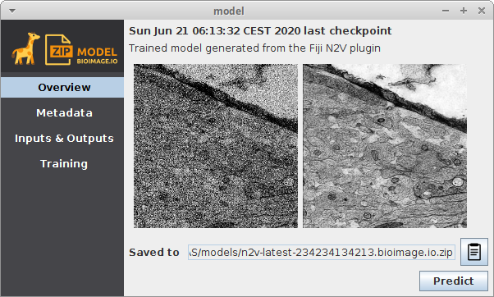
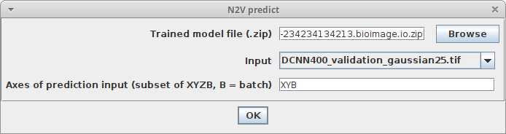
Models and prediction
each channel of each dataset needs to be trained separately
Notes:
After about 20 minutes of training, the training weight model and loss function will be obtained here. Next, you only need to put in a new image for prediction. The prediction is very fast and can be completed within one minute, and you can get the deNoised image. It should be noted that each channel of each data set needs to be trained separately

Slide 13
Comparison of Fiji vs script processing
2D with script
2D with Fiji
Raw
Notes:
Here we compare the image results denoised by the script with those denoised by fiji N2V. The two results are basically the same. On the basis of the original image, the noise is effectively reduced and the structure is smoother.

Slide 14
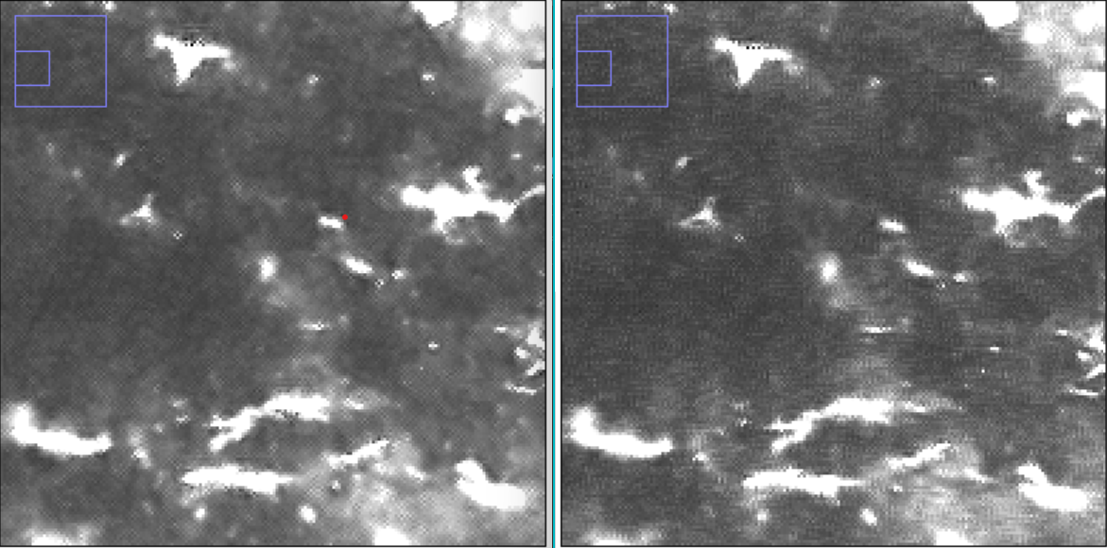
Comparison of Fiji vs script processing, zoom-in
2D with script
2D with Fiji
Notes:
After zooming in and observing the two, there is still a slight difference, and the result of fiji’s processing is slightly blurred

Slide 15
Summary and outlook
N2V was tested on a set of in-house 2-photon datasets and looks promising.
2D models are more suitable than 3D models.
Exists as an extension plugin for ImageJ, but difficult to use for multi-channel datasets.
Currently, only the Processing PC at the 2-photon microscope is equipped with a suitable (Nvidia CUDA-enabled) GPU.
A more user-friendly interface can be made to train N2V model to perform noise reduction on the multichannel 2-photon datasets.

